Slide 1

Sprint 2 Presentation
Golf Player Time Management
Adam Horle, Alyssa Beeker, Bailey Carlin, Daniel Teel, Elijah Hunt

Slide 2
Admin Site Login User Stories
“As an administrator, I want to securely login to a dashboard that provides information on current player.”
When an administrator launches the website, then he will be automatically directed to the sign in page.
When the administrator reaches the sign in page, two fields (email and password) must be entered.
When an already created email and password is entered, then the administrator is redirected to the dashboard page.
When invalid credentials are entered, then the following events will happen:
When an administrator enters an invalid email/password, then an error message will be displayed alerting them that they have entered an invalid username and/or password.
When an administrator enters no information on one or both of the fields, then an error message will be displayed saying that the field is required.
NOTE: Since this is an administrator dashboard that only they will have access to, there is no registration option on this page.

Slide 3
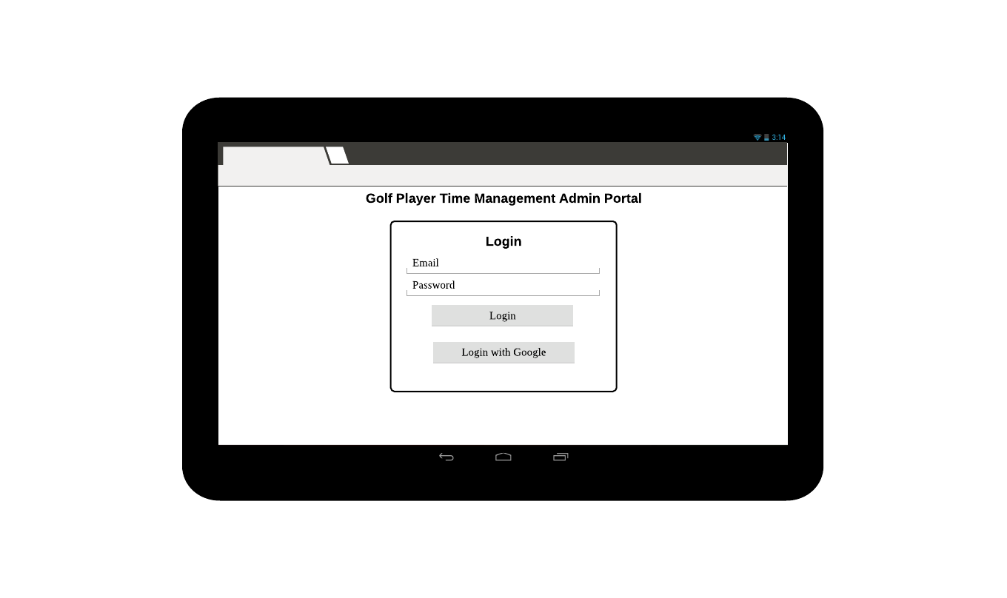
Admin Site Login UI/UX

Slide 4
Admin Site Navigation User Stories
“As a logged in administrator, I’d like to be able to navigate to multiple tabs corresponding with major functions to keep the layout easier to read.”

Slide 5
When an administrator logs in, then they will be redirected to the home page.
When an administrator logs in, there will be a toolbar at the top of the page with the app name and a logout button.
If an administrator selects the log out button, then the user’s session will expire and they will be redirected to the login page.
When an administrator is on the home page, then there will be a navigation bar on the top of the screen under the toolbar.
If an administrator is logged in, then the navigation bar will be split into 5 categories.
The categories are: home, player overview, course overview, register, and support.
If an administrator selects the home tab, then they will be redirected to the home page.
If an administrator selects the player overview tab, then they will be redirected to the player overview page with data pertaining to the current users.
The data will be split into player name, status, and the course that they’re playing at.
If an administrator selects the course overview tab, then they will be redirected to the course overview page with data pertaining to all the courses enrolled.
If an administrator selects the register tab, then they will be redirected to the register page and can create a new user account.

Slide 6
When invalid credentials are entered, then the following events will happen:
When an administrator enters an invalid email/password, then an error message will be displayed alerting them that they have entered an invalid username and/or password.
When an administrator enters no information on one or both of the fields, then an error message will be displayed saying that the field is required.
If valid credentials are entered and the register button is clicked, then the account will be created.
If the Register with Google button is clicked, then an account can be created from an already existing Google account.
If an administrator selects the support tab, then they will be redirected to the support page with helpful hints.
If an administrator is on the support page, then they will have access to a walkthrough on how to register a new player, a link to download the app from the Google Play store, a contact email, and the app’s license.

Slide 7
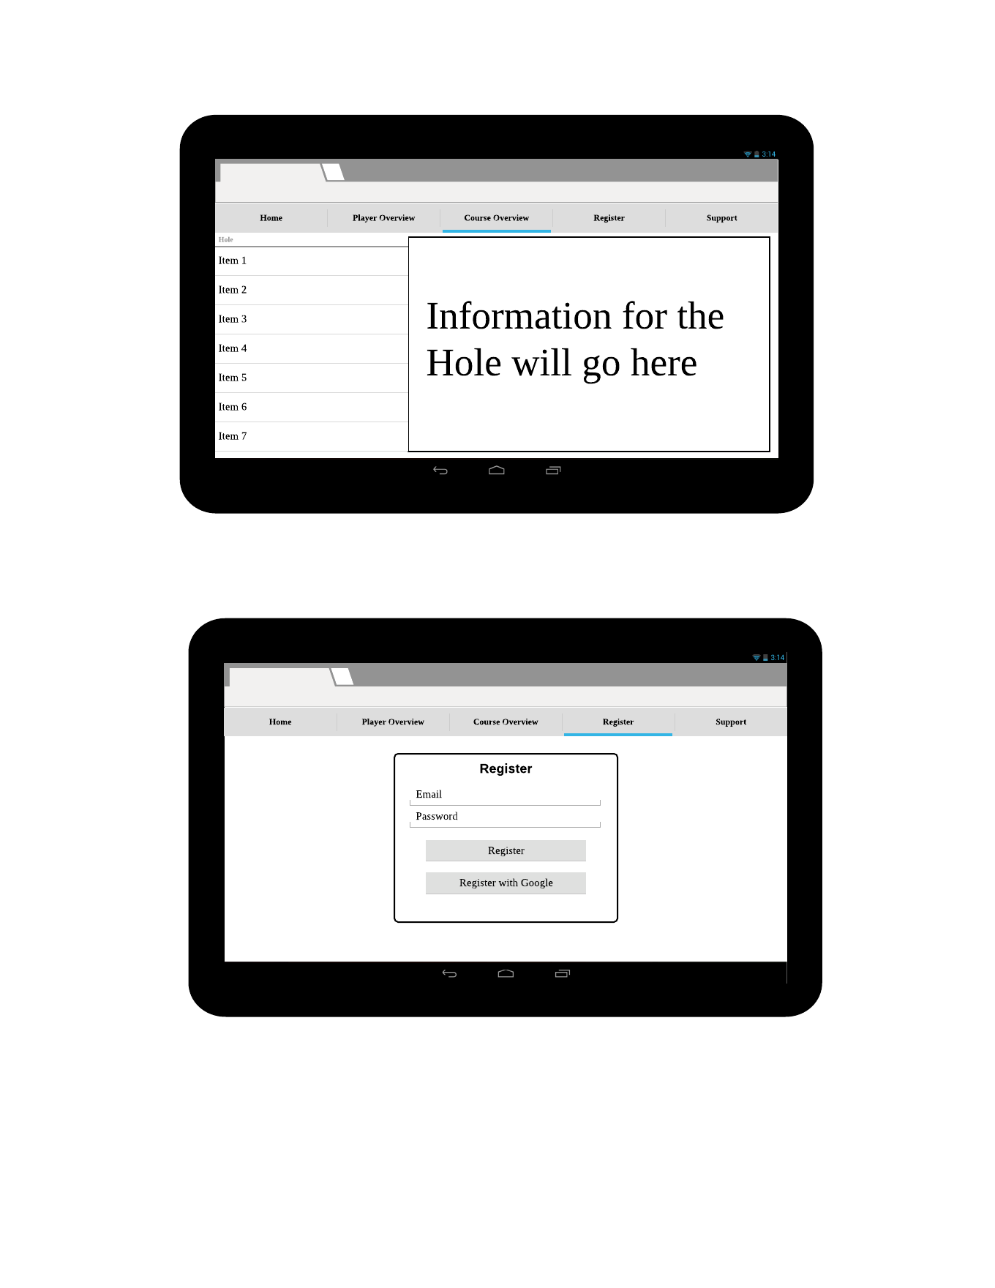
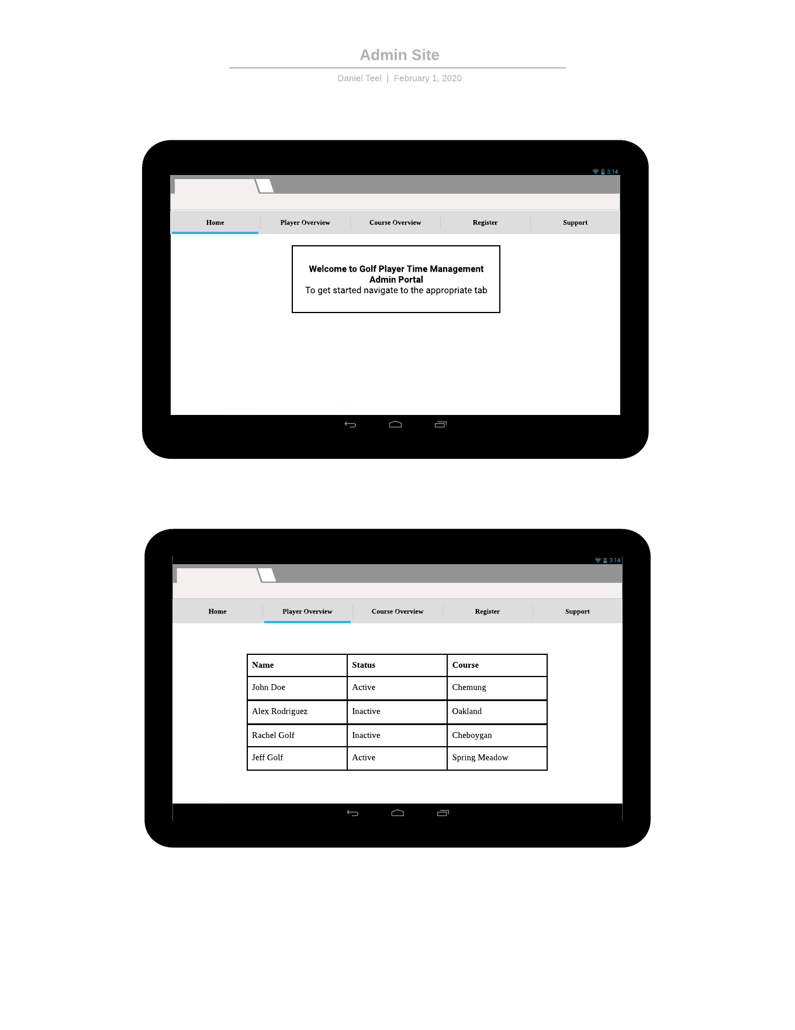
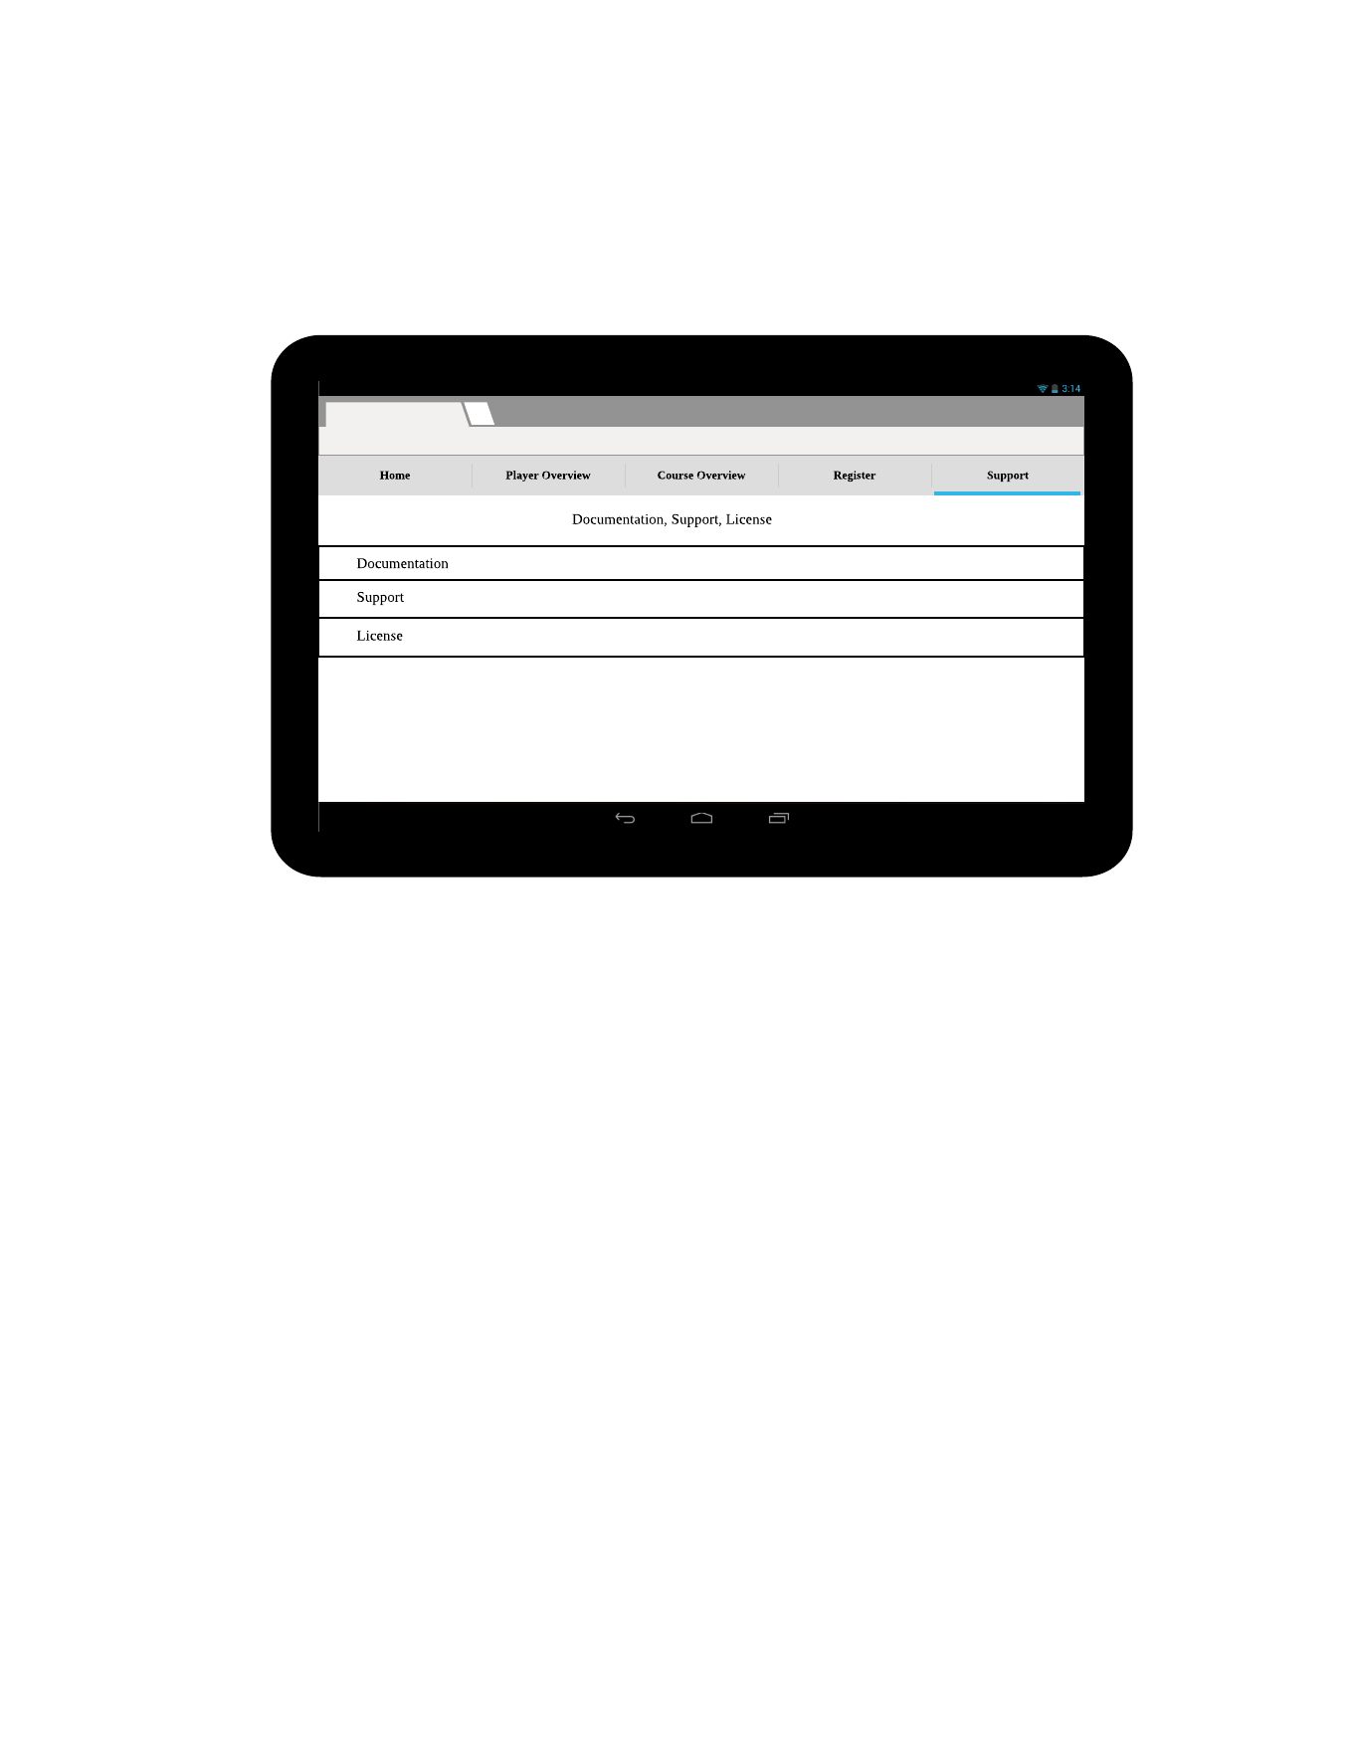
Admin Site UI/UX

Slide 8
Admin Site Initialization, Setup
Built using the Angular framework
User authentication and database provided by Firebase
Firebase used to deploy and host
2 page web app
Log in
Dashboard with 5 tabs - Home, Player Overview, Course Overview, Register, Support
Styled using components from Google’s Material library

Slide 9
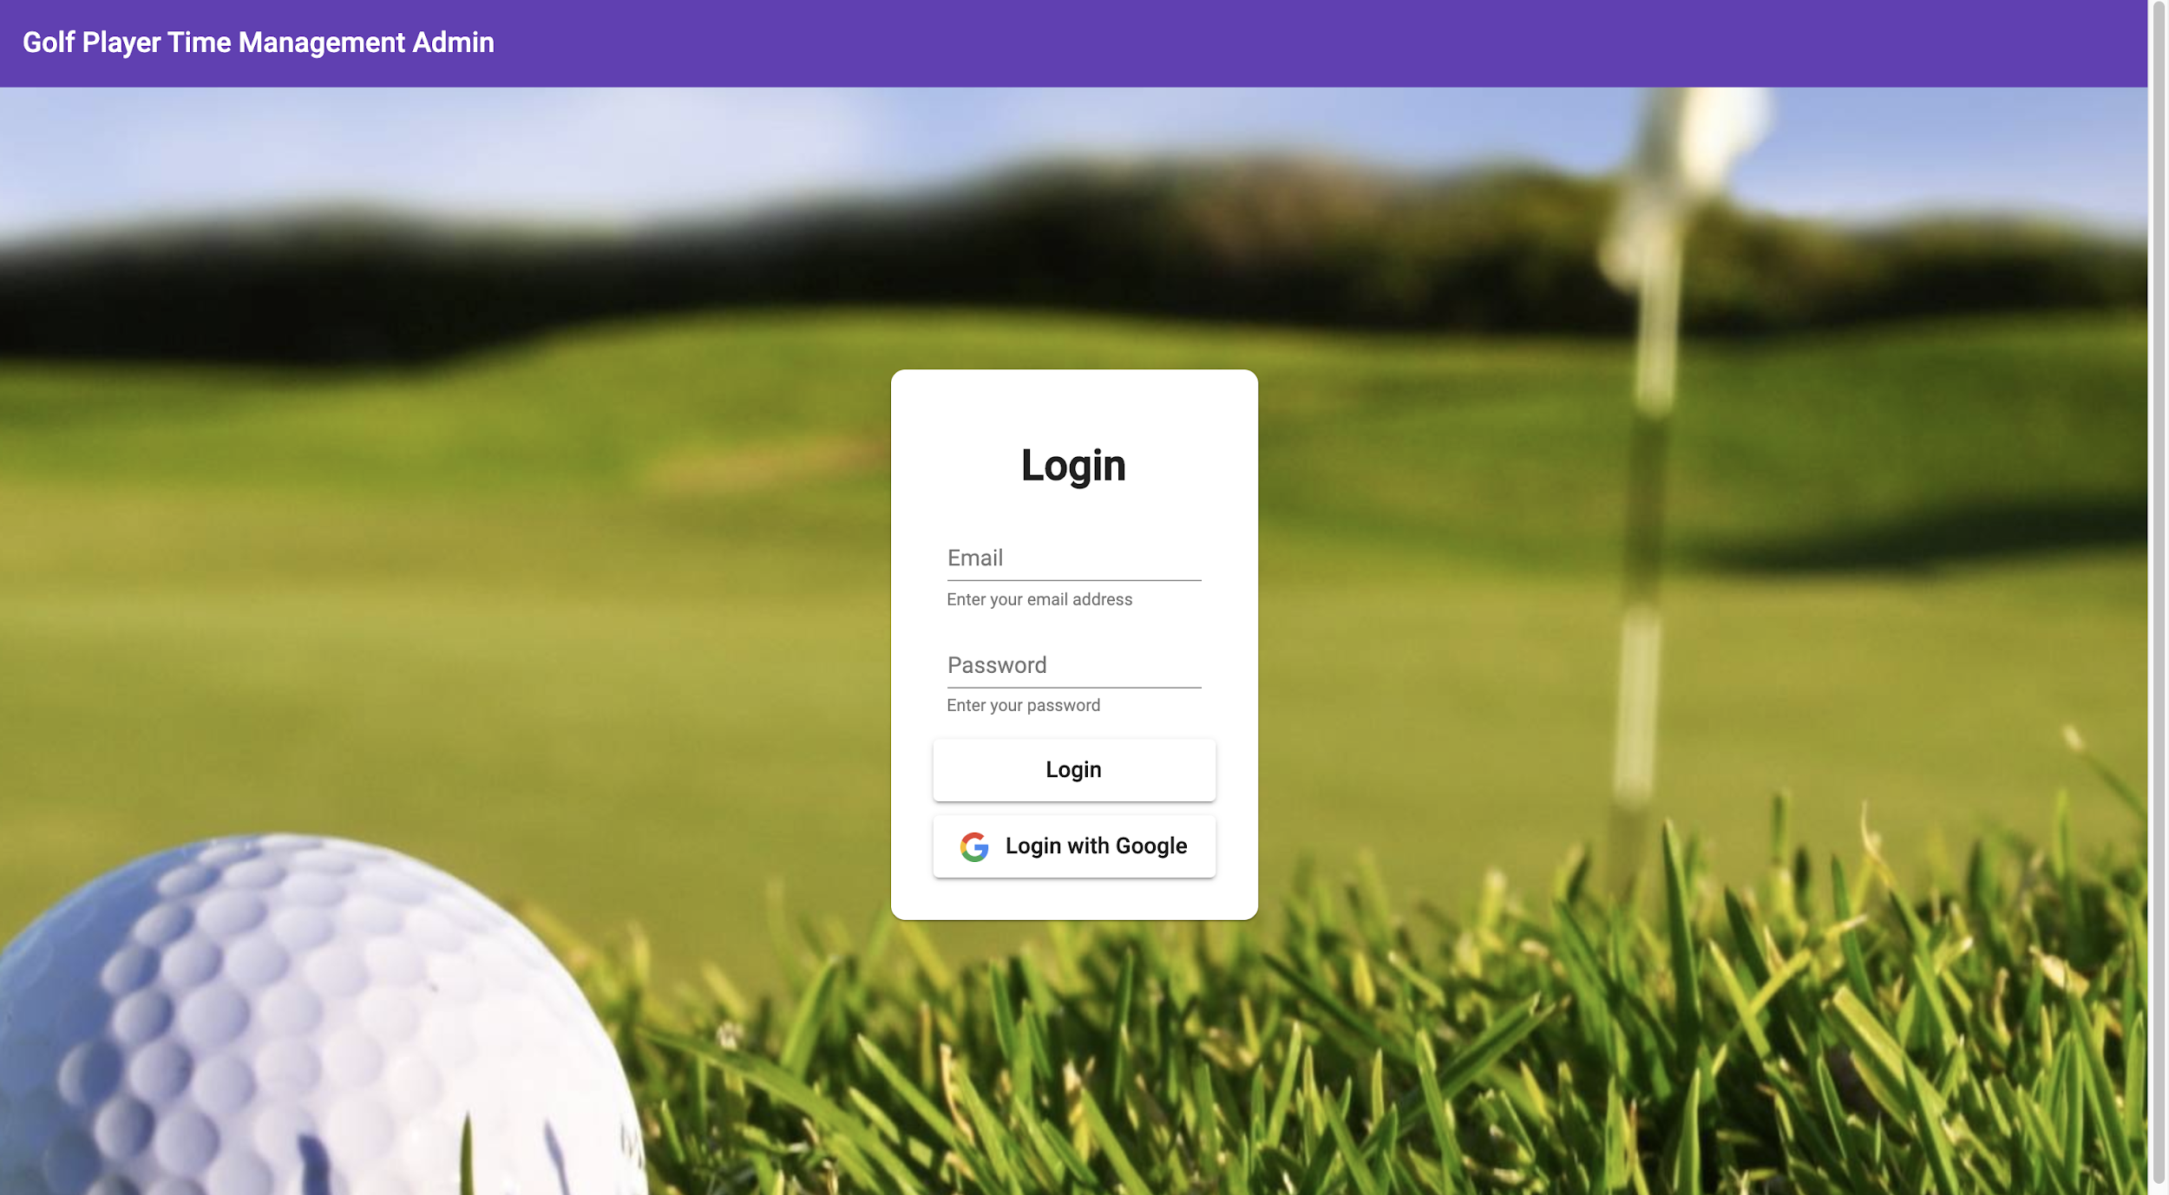
Admin Site Login
Login only possible with a pre-existing account
GTPM account - email and password combination
Registered Google account
No registration option on this page
Validators to provide users with feedback on what’s wrong

Slide 10
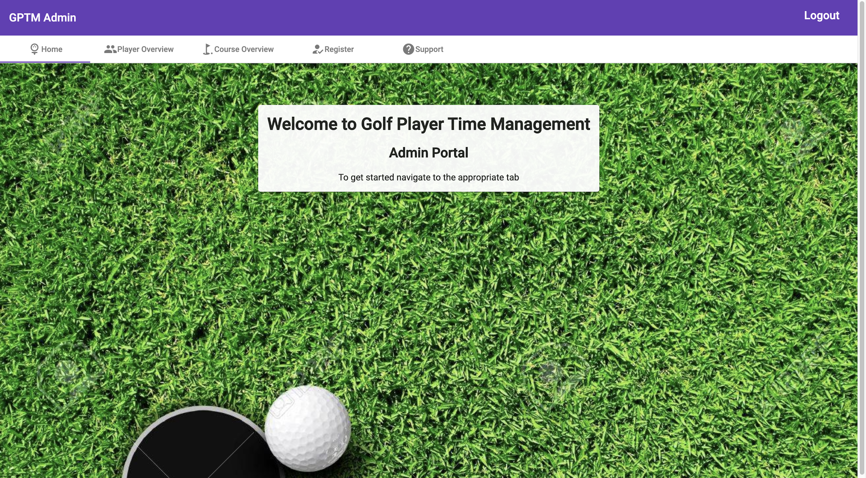
Admin Site Dashboard
Toolbar to show app name and a logout button
Tabs to navigate the dashboard to prevent clutter
Home - Welcome message, short explanation on how to navigate
Player Overview - Table of registered user with name, active/inactive, course, options to reset or disable the account
Course Overview - Overview of each hole on the course. Par, yards, players on the hole and current score.
Register - Register a new user
Support - Walkthroughs, contact info, mobile app download

Slide 11
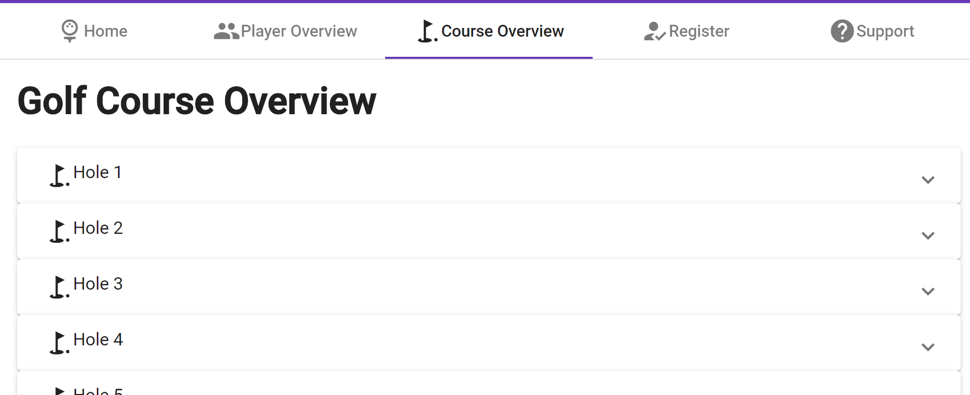
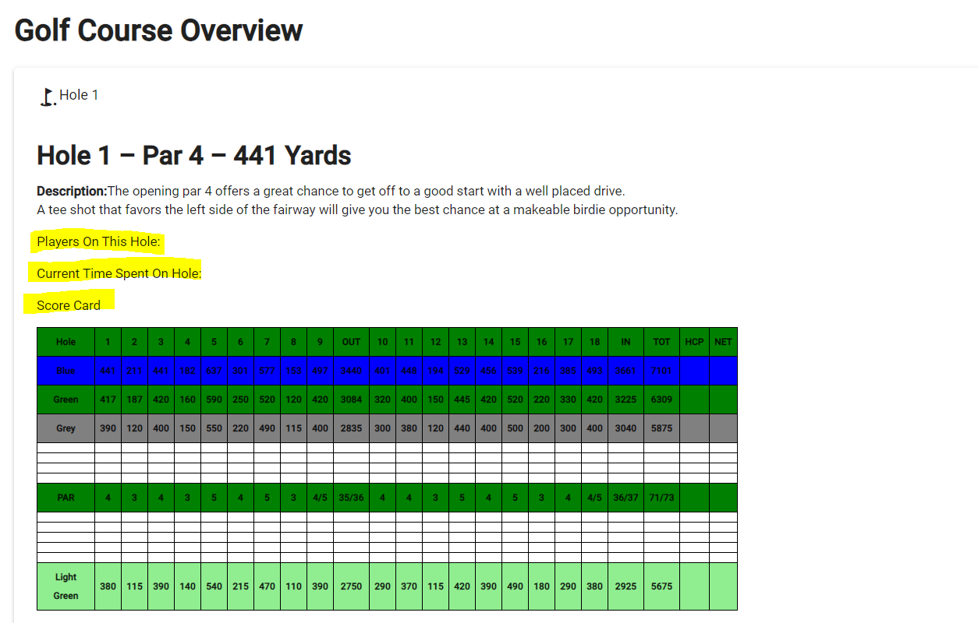
Admin Site Course Overview

Slide 12

Continuous Integration
Android CI
Builds to ensure no build errors
Angular CI
Builds to ensure no build errors
Caches node modules to speed up check time
Lints to ensure code quality

Slide 13
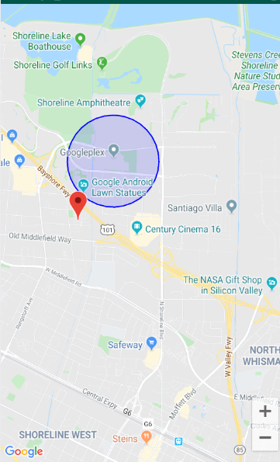
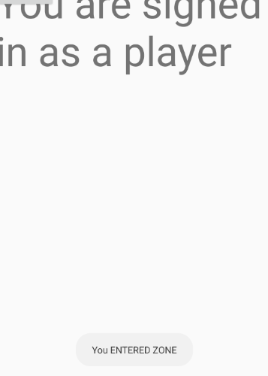
Geofencing
Using Geofire to geofence; a javascript library that uses firebase
Maps activity doesn’t like having buttons that open other activities, elegant solution was to just send user to new page instead of asking yes or no

Slide 14
Golf Course Registration
“As an admin, I want to be able to register my golf course so that players can use it on the app."
After securely logging into the app, I should be directed to the Admin Dashboard where I can open the Golf Course Registration screen.
As an admin, I can click on a button on the Admin Dashboard page that will redirect me to the Golf Course Registration page.
As an admin, I will be prompted to fill out a form asking for my golf courses’ name, address, state, zip code, description, website, and phone number.
As an admin, I can press submit after filling in every form, which then adds the information to the database.
As an admin, if I do not want to submit the form, there will be a return button so that I can return to the Admin Dashboard.
As an admin, I will be redirected to the next screen after pressing submit, which will have a message according to the success or failure of the submission.
As an admin, on the success/failure screen there will be a return button so that I can return to the Admin Dashboard.

Slide 15
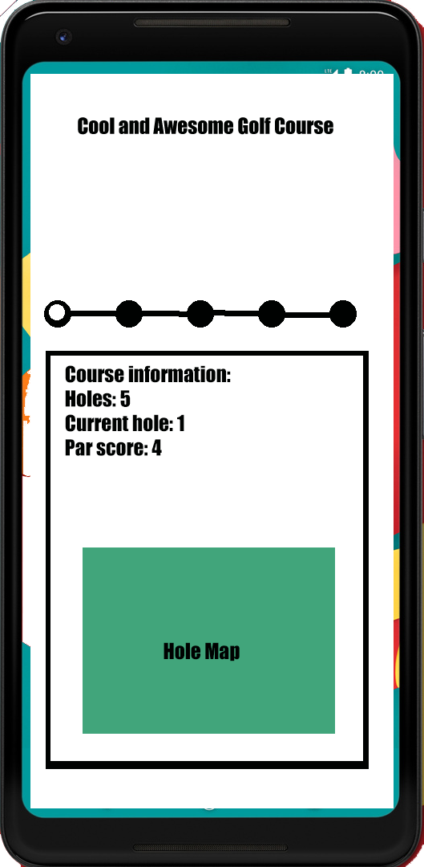
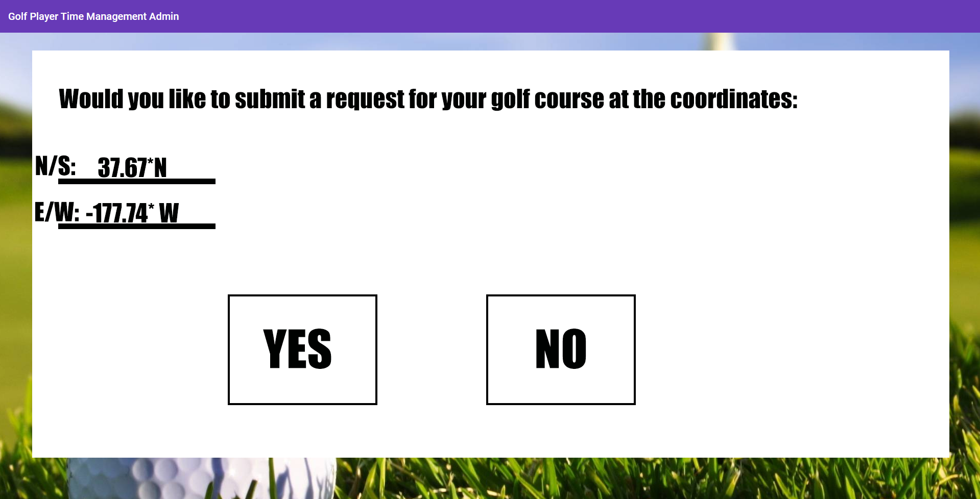
Next sprint UI/UX

Slide 16

Challenges Encountered
Scheduling conflicts
Admin Web App added on to the sprint
Learning Angular on the fly
Github problems
Almost nonexistent amount of documentation on geofencing
Current version of geofire crashes android, forced to use v. 2.3.0 rather than current

Slide 17

Sprint 3 Objectives
Develop location services and Iron out Geofencing
Develop Player Overview tab in the Admin Dashboard
Admins will register at a specific golf course.
Continue to churn out documentation

Slide 18
Demo Link
https://golf-player-time-management.web.app

Slide 19
Questions

